Slide 1

2. Generate ideas
Notes:
Teacher notes
This session helps students to generate ideas and possible solutions for their problem.
It encourages them to be creative, to research smartly and to use feedback to help them select a solution to their problem.
To complete this session, students need to be clear on the problem they are solving. They will need their key question from session 1.
If you have not completed session 1, ensure that students have an idea of what they would like to solve.
This is the second of six sessions that work through the problem-solving process. They have been designed to form a basis for a one-hour session, but they can be used flexibly and adapted to suit the needs of your class. The seventh lesson provides further information on entering Google Science Fair.

Slide 2

1
3
4
5
6
7
Identify a problem
Generate ideas
Develop a solution
Design the test
Communicate the results
Draw conclusions
Enter the competition

Slide 3
Session 2: Outline
Activity 1: Thinking outside the box Moonshot thinking Activity 2: Getting ready for your research Activity 3: Research guide Elevator pitch (optional) Continue research Picture your solution
5 mins 5 mins 6 mins 20 mins 10 mins 15 mins 5 mins
05 07 11 12 13 14 15

Slide 4


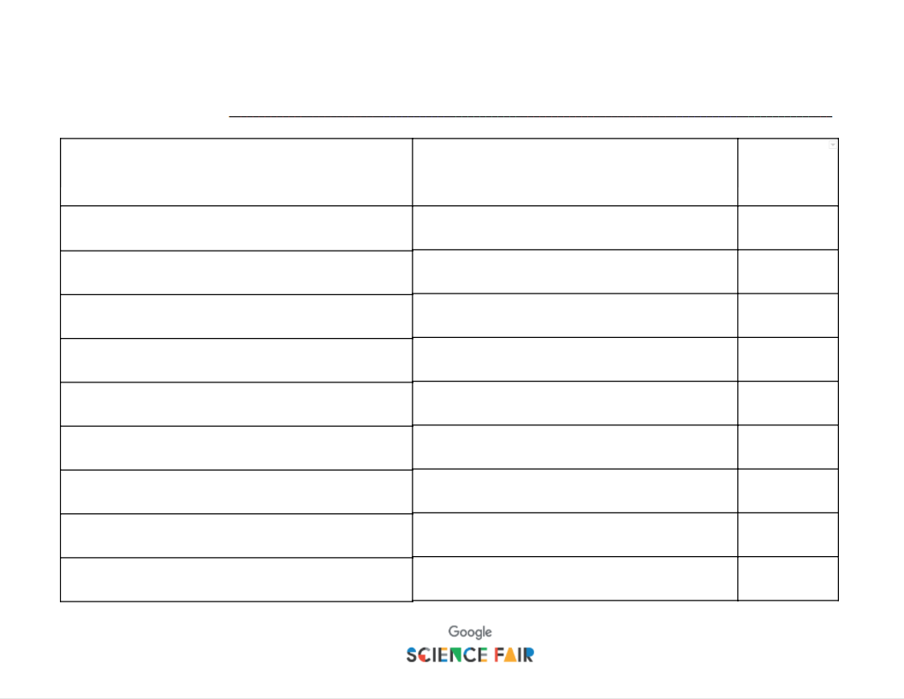

Materials you’ll need
The problem you are going to solve Computers Writing supplies Activity 1: Thinking outside the box Activity 2: Getting ready for your research Activity 3: Research guide

Slide 5
Activity 1: Thinking outside the box
Thinking outside the box
Can you link all the dots with no more than three straight lines, without lifting your pencil?
Notes:
Teacher notes
Ask students to attempt to join all nine dots with no more than three straight lines, without lifting their pencil off the page.
You could choose to show this on the screen and students can attempt with a pointer, or you can give out Activity 1: Thinking outside the box.
Give students two minutes to try to complete the challenge.
A surprising number of students will make two assumptions:
The lines cannot go beyond the outside dots.
The line must pass through the centre of each dot.
None of these “rules” were mentioned. However, these assumptions limit the answer being reached.
Encourage students to (literally) think outside the box. Give them two further minutes before revealing the answer.

Slide 6
Activity 1: Thinking outside the box
Thinking outside the box
Notes:
Teacher notes
Are students surprised by the solution?
Explain that by thinking beyond what they immediately see, they could find a simple, accessible solution.
Encourage students not to conform to what is in front of them - the best ideas are often the most ‘out there’.

Slide 7


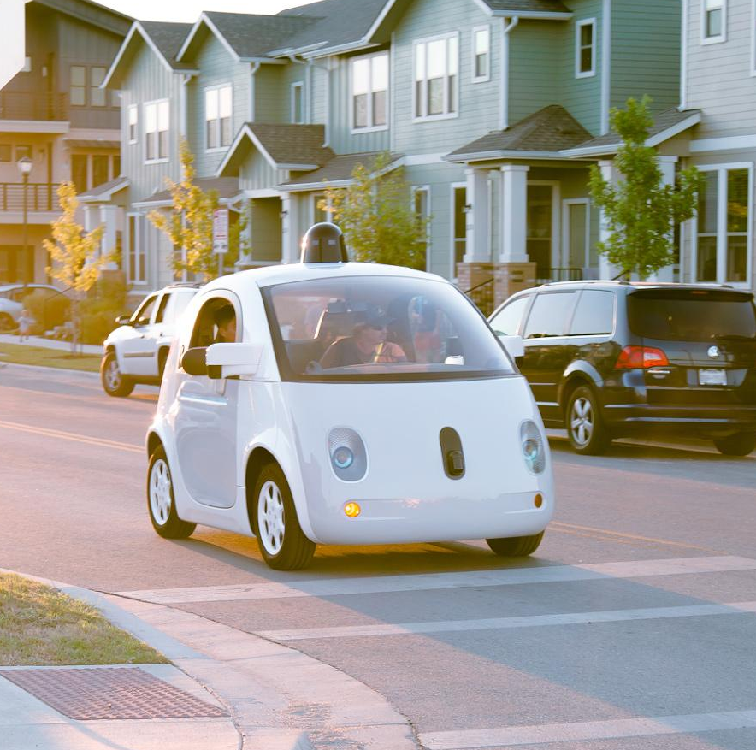
Moonshot thinking: the self-driving car
Huge Problem
1.2 million people globally die every year in road accidents
Sensors and software that autonomously and intelligently drive a car
Breakthrough technology
Radical solution
Ability to get from A to B at the push of a button
Notes:
Teacher notes
For a practical example of thinking outside the box, look at Moonshot from Google X - this takes problems, potential solutions and explores the unimaginable. One project that began in Google X and is now a product in itself is Waymo, the self-driving car.
The self-driving car project started in 2009 to develop technology that could make our roads safer and improve mobility for everyone. In October 2015, the team completed the world’s first fully self-driving trip on public roads in a car without a steering wheel, pedals or test driver.
Remind students that none of this would have been possible if someone hadn’t thought ‘what if…?’ - they shouldn’t be afraid to think big.
If you have time, you can watch a video on the development: https://waymo.com/journey/ Link to video: https://www.youtube.com/watch?v=B8R148hFxPw&feature=youtu.be

Slide 8

Idea generation
When you are thinking about your solution, always link it back to the user:
Who would benefit from self-driving cars?
What problems would be eradicated if this technology became the norm?
How could people’s lives improve because of this?
Notes:
Teacher notes
Using Waymo as an example, ask students to think about its potential impact.
Focus on the benefit that it could bring to people e.g. road safety.

Slide 9
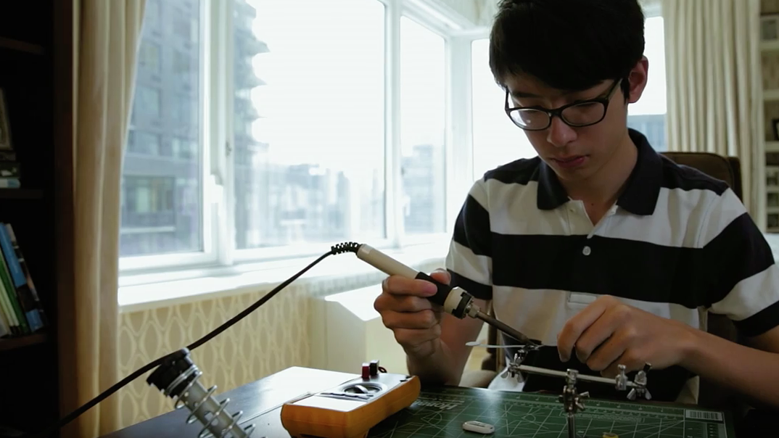

Case study
Kenneth
Shinozuka
Age 15
Play film
How can we improve the safety of people with Alzheimer’s?
Notes:
Teacher notes
Explain to students that some of the best ideas come from looking at a real-life problem that they are passionate about.
Ask students to recall their key question from session 1.
Watch Kenneth’s video to show how he developed his solution.
Next, it’s over to them to begin developing their own solution.

Slide 10
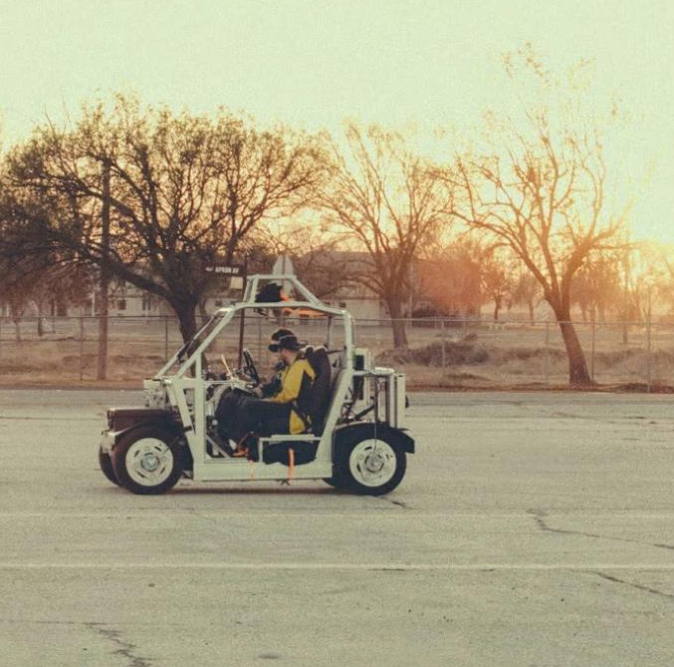
Solving the problem
Take the problem you want to solve and start to interrogate it.
At this stage, no idea is a bad idea. Give yourself total freedom with your thinking.
Which solution would help the most people?
Notes:
Teacher notes
Explain that no idea is a bad idea.
It doesn’t need to conform to what’s already out there - the best inventions completely break the mould and sprout from an idea completely different to anything that’s out there.
Recall how Google X takes something unimaginable and makes it a reality.
Now it’s their turn to be as creative as possible in their solution.
You could take the time to run through some ideas in the room - students can enter Google Science Fair by themselves or in groups of up to three, so if there are similar ideas, they might want to team up.

Slide 11
Activity 2: Getting ready for your research
The problem I want to solve: How can we provide light for children to study when they have no access to electricity?
1.
Write down any questions you have, based on the problem you want to solve.
What natural sources of energy are there? How much energy is needed to power a flashlight? How do rechargeable batteries work?
2.
Refine your questions [expand some, tighten some, split some, etc.]
Is there a local source of heat we can tap into? Which bulbs are most efficient in a flashlight? Can we recharge batteries a different way?
3.
Prioritize your questions
3. 1. 2.
Notes:
Teacher notes
Hand out Activity 2: Getting ready for your research. Ask students to complete the sheet. This short activity split into three parts:
Part 1 (3 mins): Explain that students need to think of as many questions as possible that link to the their key question, but they only have 3 minutes. Use Ann’s key question as an example (students should generate more than three questions).
Part 2 (2 mins): Students now have two minutes to reflect on and refine their questions. Again, use Ann as an example.
Part 3 (1 min): Finally, students prioritize their questions.
Students are now ready to complete their research with some better focus.

Slide 12

Activity 3: Research guide
Conduct your research!
Blogs
News
Magazines
Your teacher/mentor
Journals
Local library
Textbooks
Use the Research Guide to evaluate your sources.
Notes:
Teacher notes
Encourage students to explore a range of sources.
Hand out Activity 3: Research guide and ask students to begin researching and evaluating it as they go.
You could prompt them with these questions:
Is there an expert they can speak to in the field?
Could people who are impacted by the problem provide some insight?
Have they covered any of the relevant science or technology in their learning at school?
Are there suitable books that could help them?

Slide 13

Elevator Pitch!
No longer than one minute
Clearly describe the problem you are solving (use your key question).
What ideas have you come up with to solve?
Who will these solutions impact?
How will they change lives?
Which idea are you going to focus on and why?
Notes:
Optional
Teacher notes
Interrupt students’ research.
Explain they will each give an elevator pitch to show where they are now with their research. A timer can be used to ensure students stick to one minute.
Use this task to allow peers to contribute any ideas and to begin to get students to shift their focus onto one preferred solution.
Is there more than one person investigating a similar issue, or one they could build upon? Perhaps they could team up (maximum of three people per team).
Are students able to provide insight to help someone else out?

Slide 14



Continue your research!
Notes:
Teacher notes
If students completed the elevator pitch activity, ask them to use the feedback to refine their solution.
Encourage students to begin to hone in on one idea.
Remind students that they do not need to have their problem completely solved yet, but they should be focused on one possible idea.

Slide 15

your solution
Notes:
Teacher notes
Ask students represent where they are with their solution through a picture that summarizes a potential solution.
In the next session they will begin to develop this idea.

Slide 16
Now that you have your solution, it’s time to refine it!
Session 3: Develop a solution

